Slide 1
Machine Translation

Slide 2
INTRODUCTION
The seq2Seq model represents a category of machine learning models designed to process sequential data as input and produce sequential data as output. Prior to the introduction of Seq2Seq models, machine translation systems predominantly utilized statistical methods and phrase-based techniques, with phrase-based statistical machine translation (SMT) being the most widely adopted approach. However, these earlier systems struggled to manage long-distance dependencies and to effectively capture global context.
Seq2Seq models resolved these limitations by harnessing the capabilities of neural networks, particularly recurrent neural networks (RNNs). The foundational concept of the seq2seq model was presented in the paper titled “Sequence to Sequence Learning with Neural Networks” by researchers at Google
The evolution of neural network architectures has led to the emergence of a more advanced seq2seq model known as transformers. The research paper titled “Attention is All You Need!” was pivotal in introducing the transformer model during the Deep Learning era, marking a significant advancement in language-related models.

Slide 3

RECURRENT NEURAL NETWORK(RNN):
Recurrent Neural Network is a feedback back neural network where the output of the network is fed again to the input at each timestamp, this kind of neural network is useful in applications where sequencing or ordering is importatnt and needed to be preserved
Feedforward Network:
In feedforward network, at timestamp t=0 we input the network with the word that appears first in the sentence which is already converted into vectors using word2vec or any other data preprocessing functions. After that a weight is assigned along with the vectored input to fed it to the network.And also note that RNN loops back again, there is another weight which is assigned to the output that is generated for next time step.For t=0 , this weight is 0 as there is no input form previous time step

Slide 4
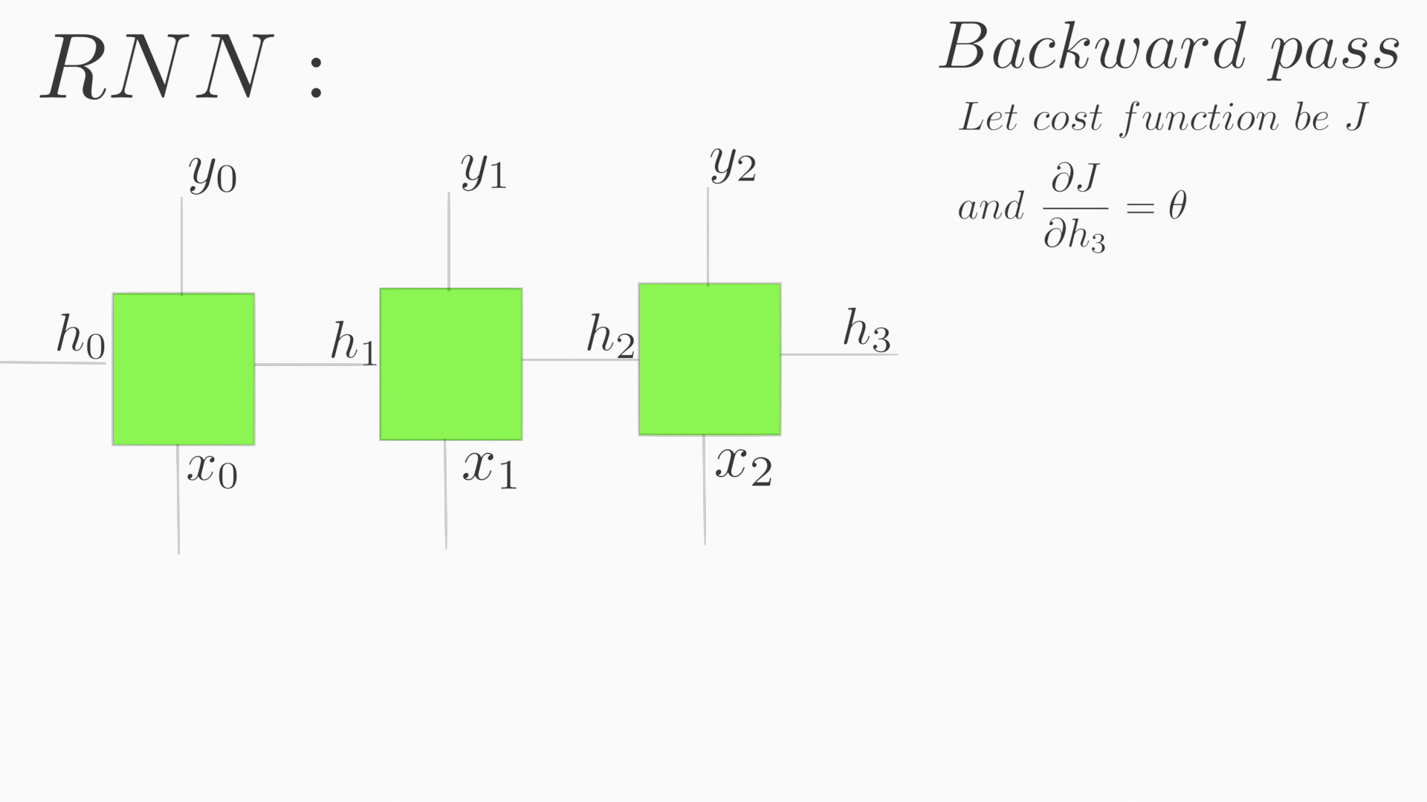
Backpropagation
In Backpropagation, the weights are adjusted according to the loss function by using optimisers like Gradient decent using chaining rule.

Slide 5
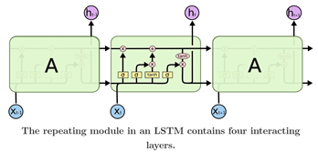
LSTM
Structure of LSTM:
LSTM consists of three gates namely input gate,forget gate and ouput gate to regulate the cell state.

Slide 6
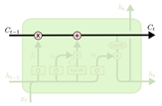
Cell State :
The Horozontal Line is the cell state where it interacts with other three gates to decide whether to keep particular information or not with respect to the current input and previous output that has been extarcted as a whole from the previous timestamp.

Slide 7
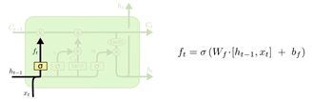
Forget Gate :
This gate tells which information need to be forgetten as it is nothing to do with the context.
The gate contains a sigmoid function where it outputs 0 or 1 to tell whether to preserve the information or not.It looks h(t-1) and x(t) to decide the information can be forgotten or not.

Slide 8
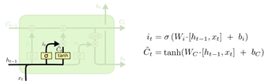
Input Gate :
This gate decides on what new information can be added into context.
It contains two parts, in the first part the sigmoid layer decides which values need to be updated and in the second part the tanh layer decides what values will be updated by creating a candidate vector.
After deciding what to forgot and what to add, we actuallty perform the operation to happen by,

Slide 9
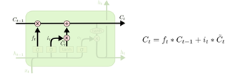
Multiplying f(t) and c(t-1) for forgetting the values and then we add i(t)*c(t) for adding new information.
Output Gate :
This gate decides what to output from the cell, it performs a sigmoid operation to decide on which parts of the cell state will be shown in output and then it is multiplied with result of tanh operation where the cell state is fed as the input.

Slide 10
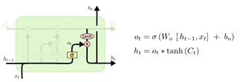

Slide 11
Encoder Decoder using LSTM
In Encoder section , the RNN(LSTM) reads the input sequentially at every time step and creates a hidden vector which will be fed into the decoder as input.
At every timestamp the hidden vector is updated with current input, the output of the RNN is ignored.
For example, consider input sequence “Iam a student” is fed into encoder.There will be four timestamps as there are four tokens,at each time step the hidden vector will get updated with respect to current input and produce the final output.

Slide 12
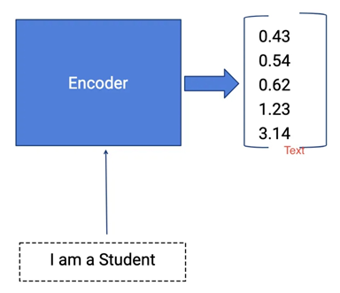

Slide 13
Decoder :
In Decoder section, it gets the hidden vector as the input from the encoder and outputs a probability distribution of each word at each timestamp which is the prediction to tell what are all the possible words that can fit into the sentence translation.This probability distribution is used to search the best fit word using Beam search algorithm.

Slide 14
Beam Search:
After getting output from encoders, we feed it into the decoder. We won’t be ignoring the output of the decoder as decoder gives us the probability distribution of the word as the output.
With the use of this decoder’s output, we use an search algorithm called Beam Search to find the exact word that matches in the context with the translating language.
Working of Beam search Algorithm:
Let’s take an example to understand the algorithm, consider a beam width of two. This beam width is considered to give us the best possible candidates as the width increases possible candidates increases.

Slide 15
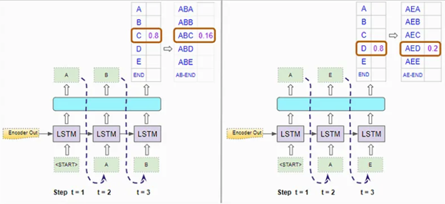

Slide 16
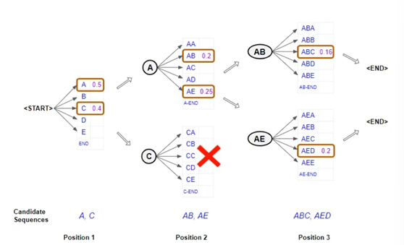

Slide 17
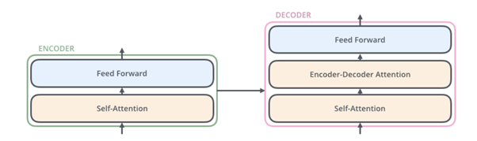
Encoder and Decoder using Transformers:
Transformers are very powerful in sequence-to-sequence translation compared to LSTM(s) as they lack in translating very long sentences. The idea behind using transformers is that it extracts the context of sentence and calculates a score with every other word in correspondence to particular processing word.
Working of Transformers:
Here we normally have encoder and decoder part like in RNN, but the input is fed all at once , each embedded word travels in separate path to get processed and finally a matrix is resulted which is fed into the decoder input.
Given below is the simplified version of Encoder decoder architecture using transformer,

Slide 18
Each encoder contains a self-attention layer and a feed forward layer. In decoder it contains both layer what encoder has in addition to that it also contains a Attention layer.
Now we can take deep dive into the working of this encoder decoder model, first input is fed into the encoder model after converting each word into vectors of size 512, these vectors first encounter self-attention model where three vectors are created namely a query vector, a key vector and a value vector for each word. These three vectors may or may not be smaller in dimension than the embedded vectors. Let’s take a simple example of one sentence “THINKING MACHINES” after vectors creation now next step is create attention scores, this score decides how much attention has to be given to other words in comparison with the word at the position that is encoded. So the first score is calculated by taking dot product with q1 and k1 , second score is calculated by taking dot product between q1 and k2.

Slide 19
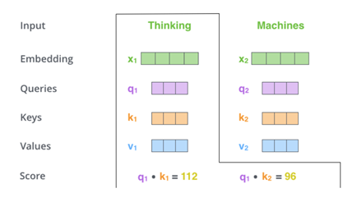

Slide 20
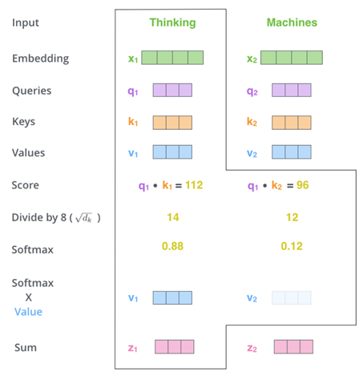

Slide 21
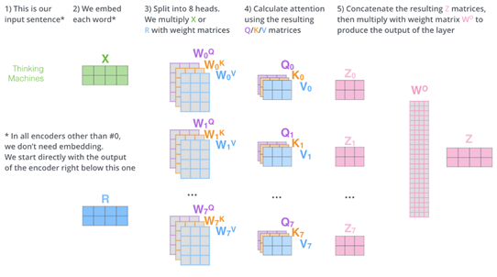
After the calculating the scores, it is divided by 8 which is the square root of the dimension of key vector. Then it is passed into the SoftMax function after that it is calculated with value vector to get Z vector.
Instead of vectors we will using matrix for faster calculation and also multiheaded self attention layer where instead of computing single z matrix eight different matrices are calculated.

Slide 22
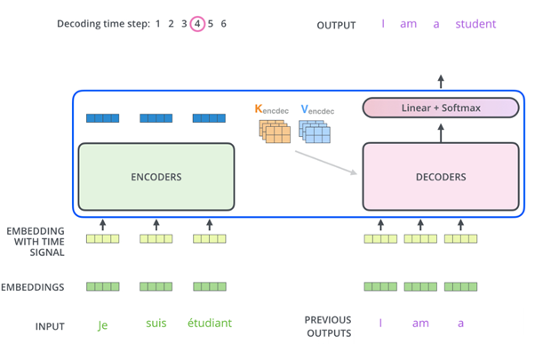
Decoder:
In decoder part, same process carried out but with slight difference that is in self-Attention layer is configured to compute earlier positions in the sequence by masking the future sequence positions. The “Encoder-Decoder Attention” layer works just like multiheaded self-attention, except it creates its Queries matrix from the layer below it, and takes the Keys and Values matrix from the output of the encoder stack.

Slide 23
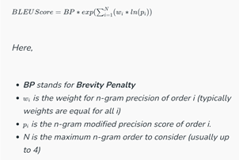
Metrics to Compare Algorithms :
BLEU score :
BLEU score is a evaluating method to check the accuracy of machine translation performed by the machine translator.
It compares the machine transalated text with the human translated text as refrence by using n-gram model.
The mathematical expression for BLEU score is,

Slide 24
Lets consider an example for understanding,
Source Text : cette image est cliqué par moi
Machine Translated Text : the picture the picture by me
Reference Text : this picture is clicked by me

Slide 25
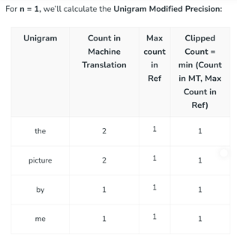
Now we have to calculate n-gram,
For the above example n is 4,so starting from n=1(Unigram )

Slide 26
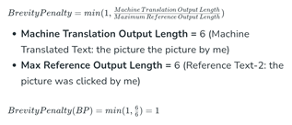
Likewise we have to calculate for n=2,3,4.
After calculating n-gram,we have to calculate the brevity score as below,

Slide 27
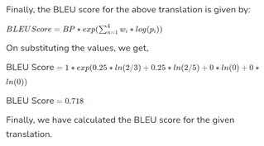
Now computing BLEU score,

